Slide 1
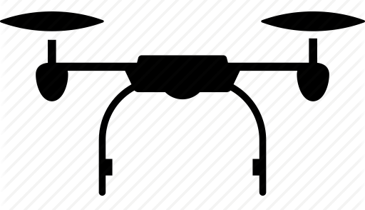

Seismic Drone Data Acquisition System
Seismic Drone(Geophone Sensors +Seismic Recorder + Data Storage +Battery)
Source (Hammer)
Epicenter
Vibrational
Waves

